Slide 1

AI Thesis Helper

Slide 2
Supervisor:
Mr. Moin Mostakim
Senior Lecturer
Department of Computer Science and Engineering
BRAC University

Slide 3
Project Student
Mirza Ahmad Shayer
22273008

Slide 4
Contents
Introduction
Literature Review and Related Works
Project Description
Project Analysis
Implementation
Conclusion and Future Works

Slide 5
Introduction
AI Thesis Helper is designed to help students with their thesis.
Works very similar to Chat-GPT but simpler to use.
From 2020 onwards Artificial Intelligence (AI) has gotten very popular.
From AI, Machine Learning (ML) progressed even further.
Then from ML, Deep Learning (DL) became a very popular field where various algorithms for various ML tasks would be made.
From 2023, Transformers changed the entire DL-architecture field. From transformers – Generative Pre-trained Transformer (GPT) was made.
Using GPT, Chat-GPT was made and then surged to popularity in the world.
Chat-GPT can answer various user questions with high accuracy and efficiency.

Slide 6
Introduction - Continued
Chat-GPT will further improve in the future.
This project is motivated to help students during their thesis.
Will mitigate various problems for students so they can focus more on research.
Will also aid teachers as well.
This chat-bot is designed for a specific purpose. Also to mitigate various issues with general chat-bots.
Problems are discussed with main issues being, grammar, spelling and information errors during thesis writing.
Aim of project is to build a chat-bot that answers student questions on thesis topics, formats and ideas.

Slide 7
Introduction - Continued
The objectives of the project are:
Answer student questions.
Give explanations.
Summarize and paraphrase paragraphs.
Explain paragraphs and other information.
Spelling and grammar checking.
Simple intractable interface.
Customizable interface.
Some challenges were there with resources, dataset and machine training.

Slide 8
Literature Review
Transformers have helped in building GPT which in turn was a big help in making Chat-GPT.
Has made Natural Language Processing (NLP) easier and more advanced.
Helped in formation of various Large Language Models (LLM). Like BERT, RoBERTA and GPT-3. Dialo-GPT and T5 transformers are also other examples.
Higher scalability, reading capabilities and more easier processing of data.

Slide 9
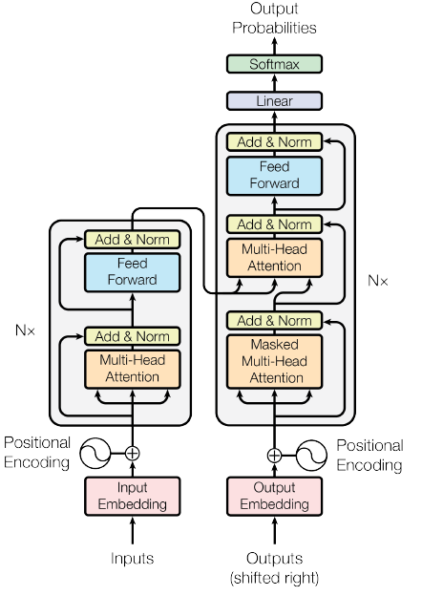
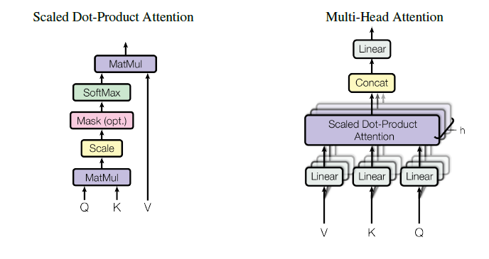

Related Works
Transformers are studied in detail.
Transformers take in data and returns a representation sequence in a matrix form of size $DxN$.
Equation - $X^{m}=transformer −block(X^{(m−1)})$
Scaled Dot-Product Attention and Multi-Head Attention
Transformer Architecture

Slide 10
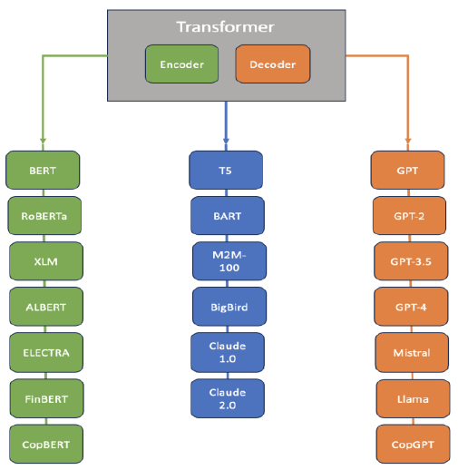
Related Works - Continued
Various Transformer Models
Why GPT was chosen over other models?
Better in text generation as opposed to other models.
Requires less data as it is already pre-trained. Only fine-tuning is required.
More better and accurate text generation and understanding.

Slide 11
Project Description
Project has various requirements.
User:
Need internet access
URL to go to application
Start conversing
Can close after using
Tools Utilized:
IDE:
Google Colab
VScode
Programming Languages:
Python
HTML
CSS
System:
Laptop or Desktop
Internet access
Optional – 1080p Monitor
Libraries
PyTorch
Transformers
GPT2-model
Framework
Gradio

Slide 12
Project Description - Continued
Computational Requirements.
Hardware:
Components | Minimum | Maximum
Processor | Core i3/Ryzen 3 | Core i7/Ryzen 7
RAM | 2GB | 8GB
Graphics | 2GB | 8GB
OS | Windows 7/8 | Windows 10/11
Software:
Component | Software
Browser | Google Chrome or Mozilla Firefox
IDE | Google Colab and VScode
Languages | Python and HTML and CSS
Libraries | PyTorch, Transformers and GPT2-model

Slide 13
Project Description - Continued
Pros and Cons.
Pros:
Simple to use
Anyone can use
Quick answers
Answers can change
Background color customization
Browser based no downloads
Cons:
Requires internet
Only works on some browsers
Limited answers
Windows only
Mistakes in answers
Feasibility.
Technical:
Correct spelling and grammar
Precise answers
Answers in quick time
Requires less thesis resources
Economic:
Reduces time to finish thesis
Less time for idea generation
Less time for checking
Less stress, more research
One teacher, more students

Slide 14
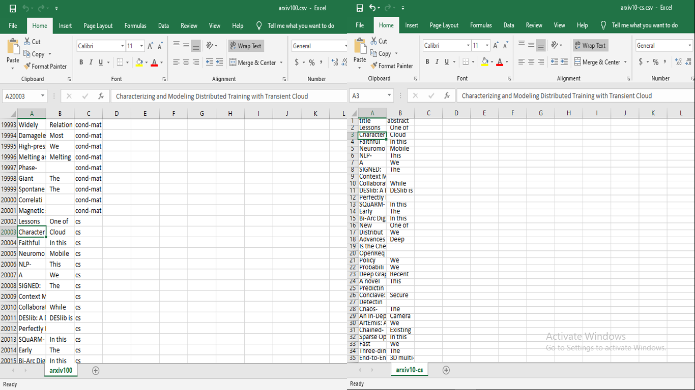
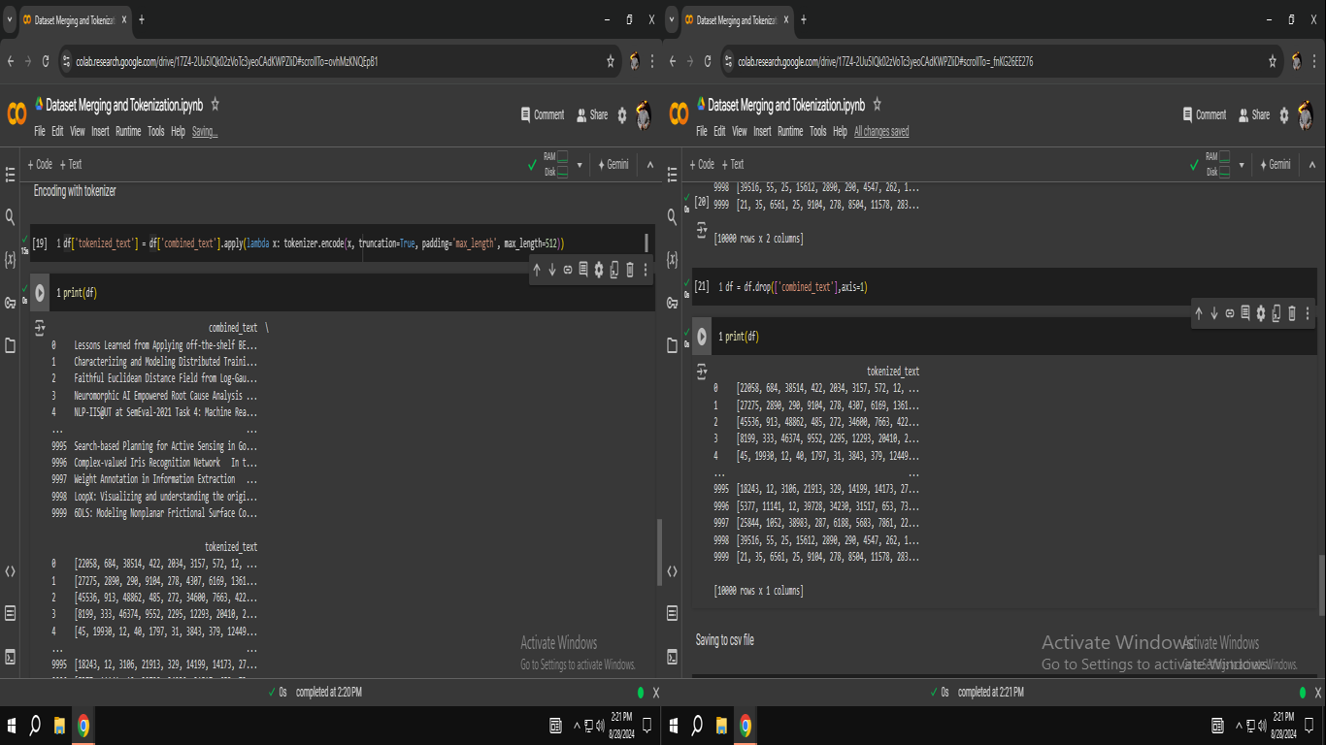
Project Analysis
Full project is discussed.
Dataset – From “Arxiv-100” Dataset – “Arxiv-10-CS” Dataset is made. Arxiv-100 has 100,000 papers data with three columns – title, abstract and label. There are 10 labels each with 10,000 papers. Only “CS” label papers are taken to form the “Arxiv-10-CS” Dataset. “Arxiv-10-CS” Dataset has two columns title and abstract. The dataset is then pre-processed – both columns are combined. Then it is tokenized with the GPT2Tokenizer and the Tokenizer parameters- truncation = true, padding = maxlength with maxlength = 150.
Arxiv-100 (Left) and Arxiv-10-CS (Right)
Pre-Processed (Left) and Tokenized (Right)

Slide 15
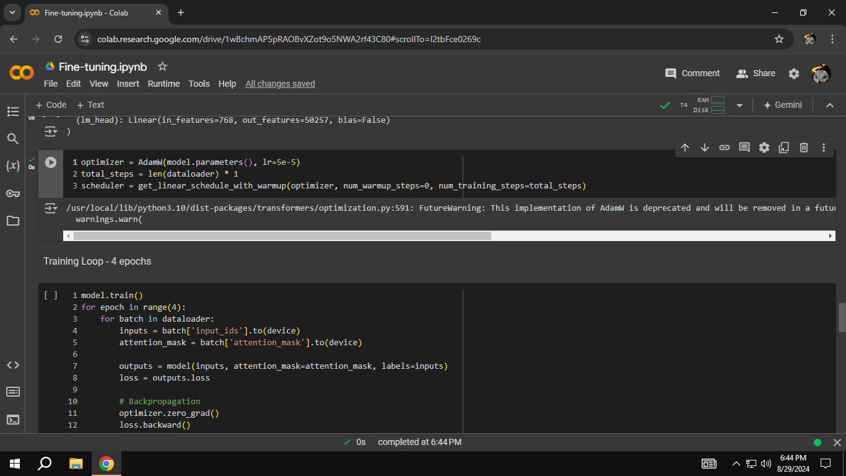
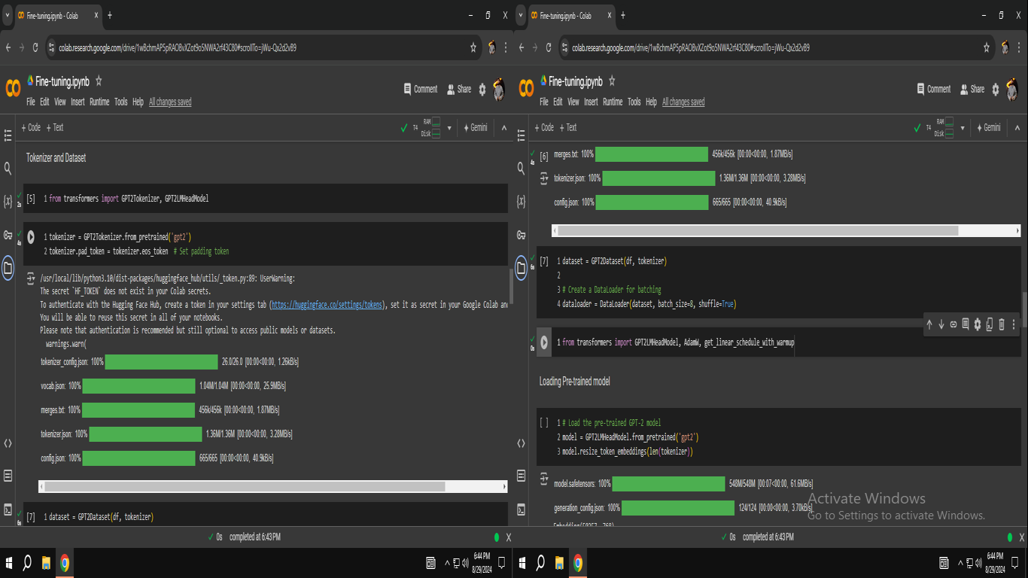
Project Analysis - Continued
Model Fine-Tuning – With the dataset now tokenized, the model can be fine-tuned. The tokenized dataset is uploaded and the GPT2 dataset class is made with functions. GPT2Tokenizer and GPT2LMHeadModel are imported. Dataloader parameters for making batches are batch−size = 8 and shuffle = True. For Hyperparameters - Optimizer is AdamW, learning rate lr = 5e−5. Total steps is length of data loader which is 10, 000 ∗ 1 = 10, 000. Model runs for 4 epochs as model already pretrained. 11.6GB of 15GB is used of the Colab T4-GPU. Also excessive training is not possible. Total training time 1 hour, 39 minutes and 20 seconds. 25 minutes for each epoch. Model saved and downloaded.
Hyperparameters
Model Tokenizer, Dataset and Dataloader

Slide 16
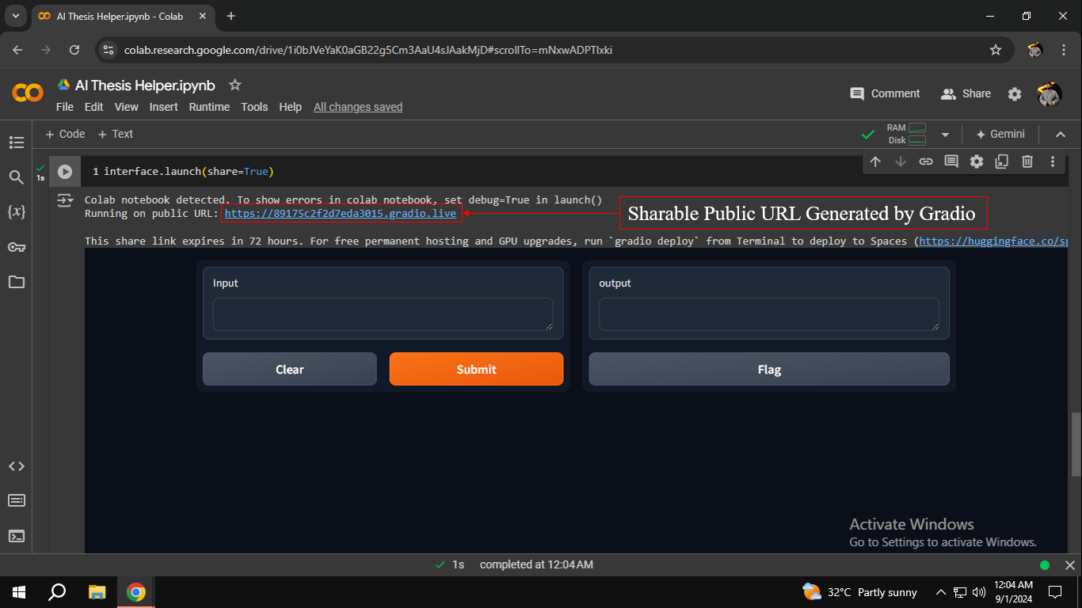
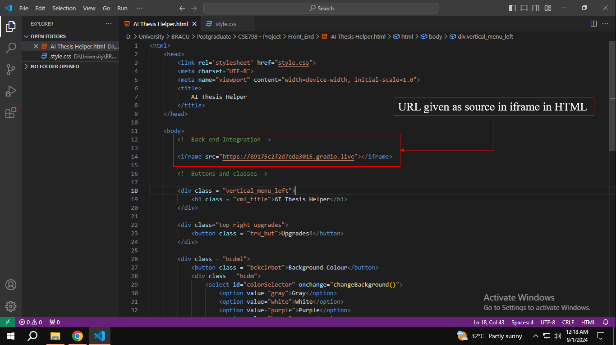
Project Analysis - Continued
Back-end and Integration – The back-end of the application is made in Colab. The Gradio Framework is used for integration between back-end and front-end. Gradio is installed and the back-end interface is made, then Gradio automatically gives a public URL address to host this. The link is active for 3 days. The URL is then pasted on the “src” of the iframe of the HTML of front-end.
Back-end with URL in Colab using Gradio
URL pasted in src of HTML front-end

Slide 17
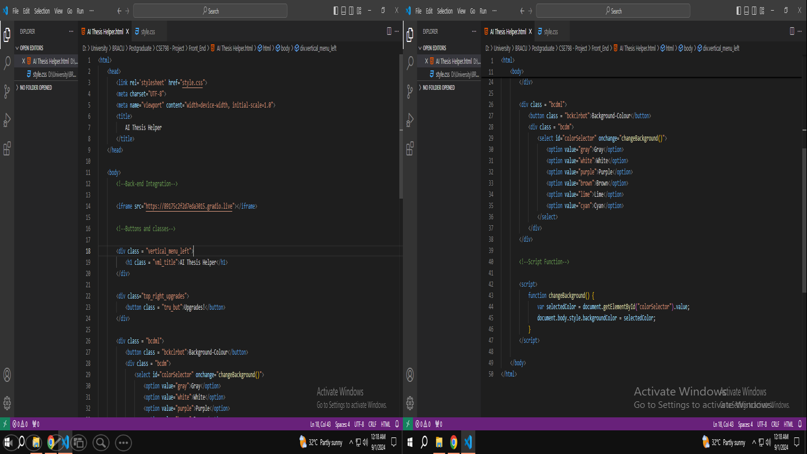
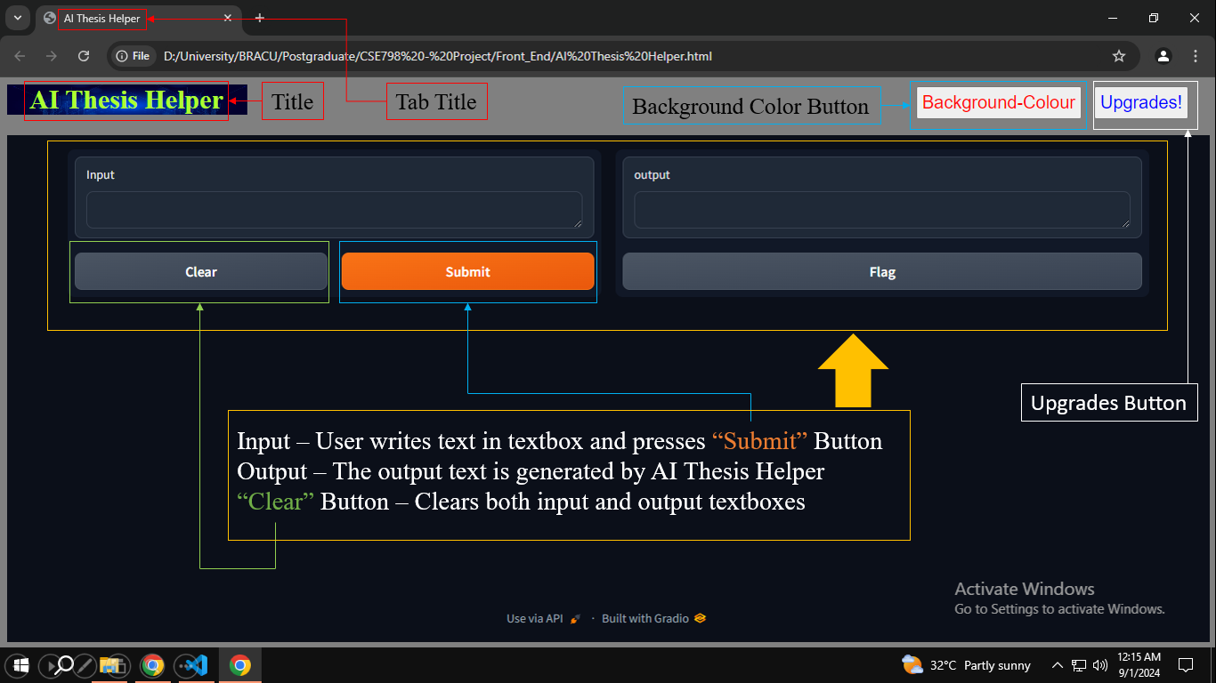
Project Analysis - Continued
Front End and UI/UX Components – The front-end and the UI/UX components are made in VScode IDE in HTML and CSS. The iframe is taken from the back-end via Gradio interface. Background color changes via the background color button and the upgrades button simply displays a simple message of future updates to come. The Gradio interface gives the input and output text boxes. User inputs and submits the text and output is processed and generated. Clear button clears both input and output.
HTML Front-end
Labelled UI/UX Components

Slide 18
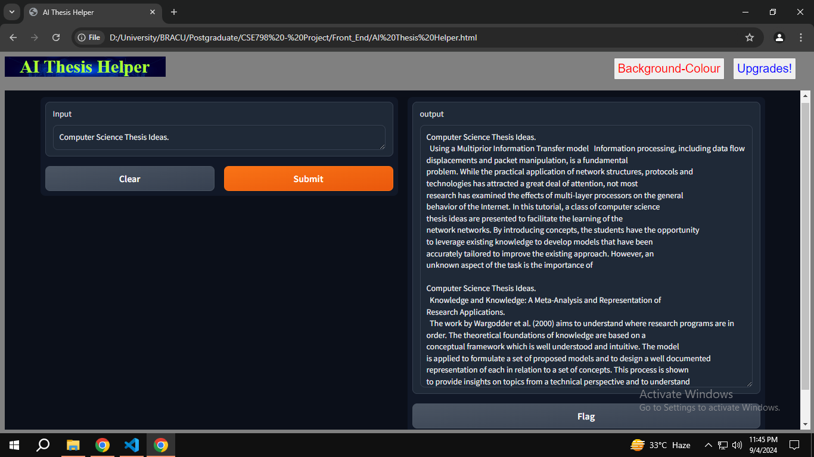
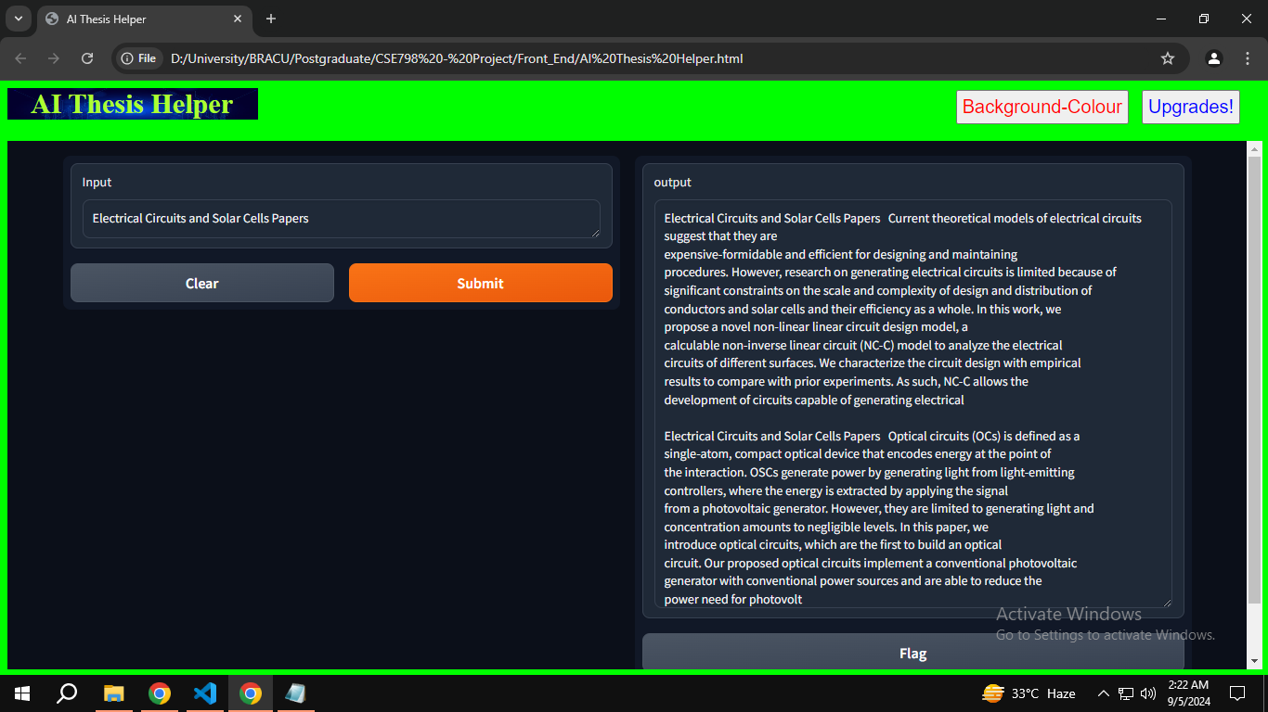
Implementation
The project is implemented and the performance of the project is evaluated using the following metrics – Model Loss during training, Precision, Recall and F1 Score followed by Perplexity. Perplexity is probability distribution of words generated. Quantifies how well the model can predict the next word in any given sequence. A comparison is made of model generated answers with answers of Chat-GPT and Perplexity AI to the text input – “Computer Science Thesis Ideas”.
Computer Science Thesis Ideas
Electrical Circuits and Solar Cells

Slide 19
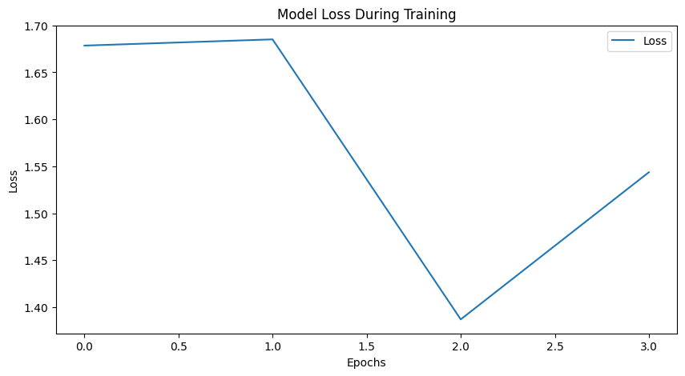
Implementation - Continued
Model Loss, Precision, F1 Score, Recall and Perplexity are shown here. Precision, F1 Score, Recall and Perplexity are calculated about 3 times with three different inputs and then averaged to get better understanding of model performance.
Model Loss over 4 epochs

Slide 20
Implementation - Continued
Precision, F1 Score and Recall
Text Input | Precision(%) | Recall(%) | F1 Score(%)
Computer Science Thesis Ideas | 79.5 | 79.5 | 79.5
Transformer Research Papers | 79.7 | 78.4 | 79.1
Electrical Circuits and Solar Cells Papers | 80.2 | 78.1 | 79.1
Total Average | 79.8 | 78.7 | 79.2
Perplexity
Text Input | Perplexity
Computer Science Thesis Ideas | 16.588
Transformer Research Papers | 14.426
Electrical Circuits and Solar Cells Papers | 14.134
Total Average | 15.049

Slide 21
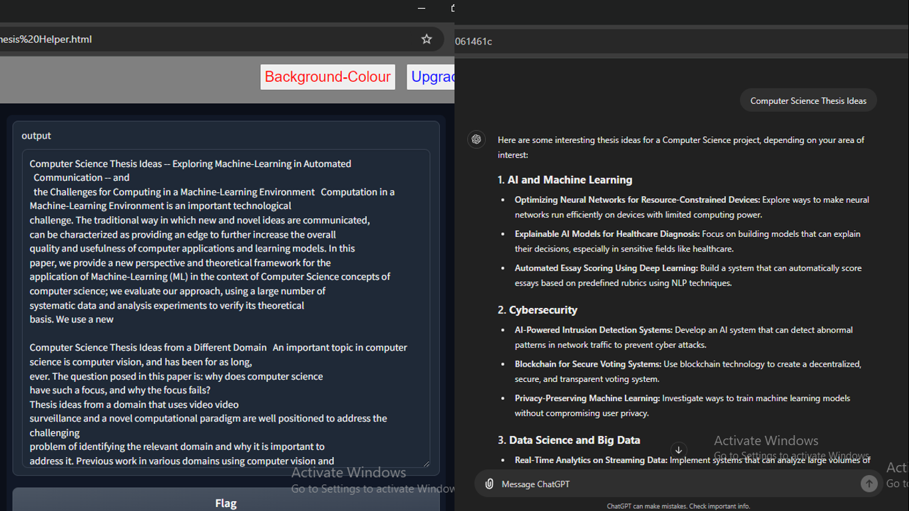
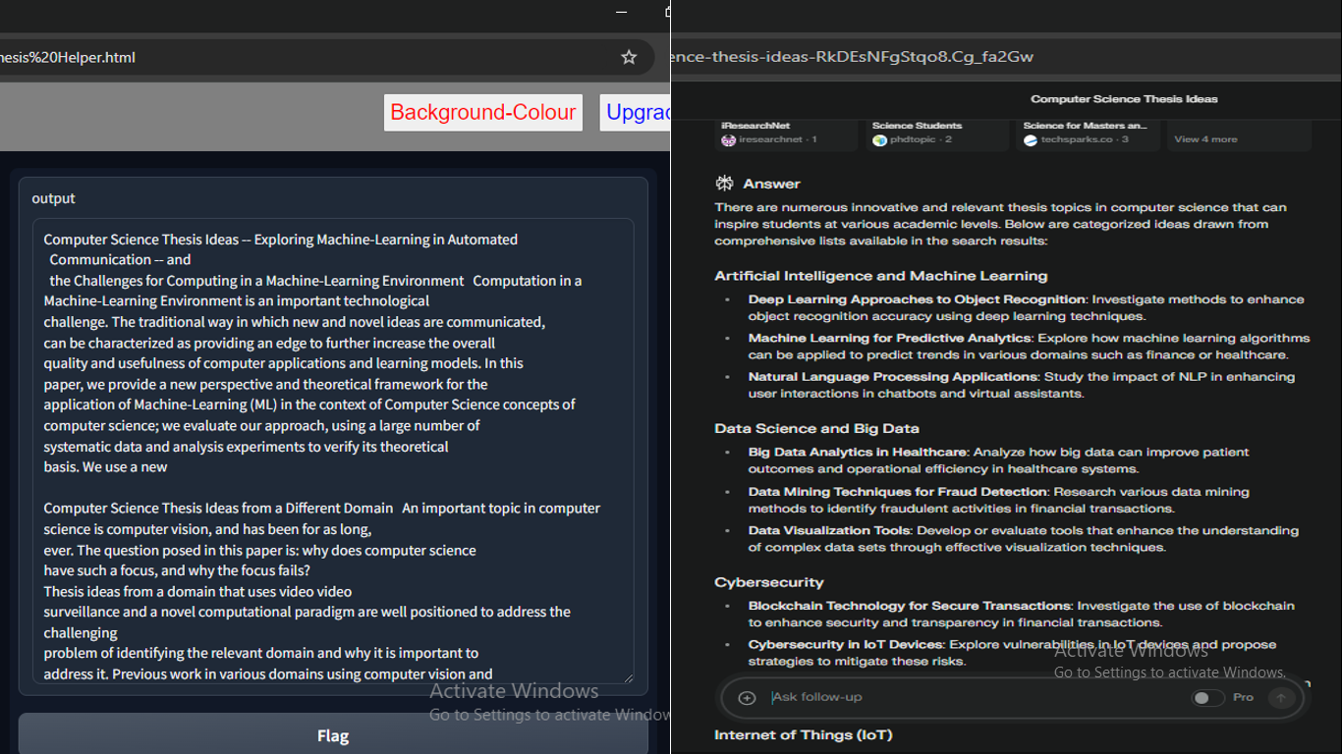
Implementation - Continued
Here a comparison of text generation of the model to two other chatbots Chat-GPT and Perplexity AI with the text input “Computer Science Thesis Ideas”. It is to show the performance of the model. All text generation is similar although Chat-GPT and Perplexity AI answers are more organized. Both use state of the art latest LLM models compared to the fine-tuned GPT2 model.
AI Thesis Helper (Left) and Chat-GPT (Right)
AI Thesis Helper (Left) and Perplexity AI (Right)

Slide 22
Conclusion
AI Thesis Helper aims to help students with their thesis writing.
Objectives - spelling and grammar checking, to summarize and to generate good topics easier.
Challenges - resource limits and dataset availability.
Literature review discusses large language models and Transformers. ChatGPT is discussed as well and why GPT was chosen over other models.
Requirement analysis discusses system – hardware and software, user requirements, pros and cons with economic and technical feasibility. The tools used are also elaborated – IDE, Languages and Libraries.
Project Analysis discussed – Dataset, preprocessing and tokenization. Fine-tuning, back-end, integration, front-end with UI/UX components all elaborated.
Project Implementation explained – Model loss, Precision, F1 score, Recall and Perplexity. Comparison of model answer generation with Chat-GPT and Perplexity AI for same input to see performance.

Slide 23
Future Works
Will be able to run on other browsers OperaGX, Brave Browser, Safari and other Linux based ones.
Development for smartphones, notepads and notebooks etc.
Will work on previous windows versions Windows XP/2000 - reverse compatibility.
More customizations added.
Various chat-bot modes.
Higher level features.
Advanced coding and equation generation.
Wireless device use for remote tuition.

Slide 24
References
D. Duijst, “Can we improve the user experience of chatbots with personalisation?,” Jul. 2017. doi:10.13140/RG.2.2.36112.92165.
A. Fadhil, “Domain specific design patterns: Designing for conversational user interfaces,” CoRR, vol. abs/1802.09055, 2018. arXiv: 1802 . 09055. [Online]. Available: http://arxiv.org/abs/1802.09055.
P. John and N. Woll, “Using grammar checkers in the esl classroom: The adequacy of automatic corrective feedback,” pp. 118–123, Dec. 2018. doi: 10.14705/rpnet.2018.26.823.
V. R. Tarun Lalwani, “Implementation-of-a-chatbot-system-using-ai-and-nlp,” International Journal of Innovative Research in Computer Science and Technology (IJIRCST), vol. 6, no. 3, pp. 26–30, 2018, issn: 2347 - 5552. doi: 10.21276/ijircst.2018.6.3.2.
J. Park, “An ai-based english grammar checker vs. human raters in evaluating efl learners’ writing,” vol. 22, pp. 112–131. Sep. 2019. doi: 10.15702/mall.2019.22.1.112.
T. Zhang, V. Kishore, F. Wu, K. Weinberger, and Y. Artzi, “Bertscore: Evaluating text generation with bert,” Apr. 2019.
D. Hl´adek, J. Staˇs, and M. Pleva, “Survey of automatic spelling correction,” Electronics, vol. 9, no. 10, 2020, issn: 2079-9292. doi: 10.3390/electronics9101670. [Online]. Available: https://www.mdpi.com/2079-9292/9/10/1670.
R. Kumar and M. Mahmoud, “A review on chatbot design and implementation techniques,” International Research Journal of Engineering Science Technology and Innovation, vol. 07, p. 2791, Feb. 2020.
R. Tamrakar and N. Wani, “Design and development of chatbot: A review,” Apr. 2021.
R. Alegado and R. Luciano, “Design and development of chatbot request system,” Jun. 2022. doi: 10.13140/RG.2.2.11593.01123.
M. H¨am¨al¨ainen, K. Alnajjar, and T. Poibeau, “Modern french poetry generation with roberta and gpt-2,” Jun. 2022.
W. Lun, M. Muhammad, K. P. Chuah, N. Saimi, A. Maarop, and R. Elias, “Did you run the telegram? use of mobile spelling checker on academic writing,” Multilingual Academic Journal of Education and Social Sciences, vol. 10, pp. 1–19, Jan. 2022. doi: 10.46886/MAJESS/v10-i1/7379.

Slide 25
Thank You
Any Questions?

